Slide 1
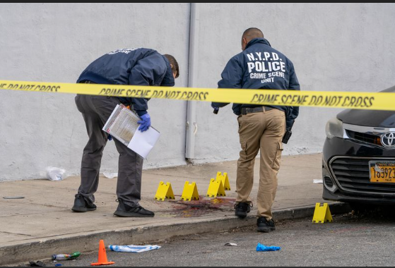
NYPD Shooting Incident Data (Historic:2006-2023)
By: Tejalakshmi Gangadhar, Chalumuri
Instructor: Dr. Christelle Scharff

Slide 2
Project Proposal
Targeted Problem
Gun violence is rapidly escalating in urban neighborhoods of NYC, highlighting the need for a comprehensive spatial and temporal analysis to understand contributing factors and impacts.
High-Level Description & Justifications
The rise in gun violence requires targeted intervention, informed by data on the locations, times, and socioeconomic conditions that correlate with these incidents.
Research Questions
How has gun violence fluctuated across time and by neighborhood?
Which demographics and neighborhoods are most affected?
Are there temporal or locational patterns?
Dataset
Source: NYC Open Data, NYPD Historical Shooting Incidents
Description: Contains 28,600 rows of data spanning from 2006-2023, including geospatial and temporal attributes (date, time, location, victim demographics).
Motivation
Technical: Opportunity to use EDA, geospatial, and machine learning techniques.
Personal: Desire to contribute to public safety through data-driven insights.

Slide 3



Abstract
Understanding patterns, Contributing Factors and Implications
Urban Increase in Gun Violence : NYC has seen a rapid escalation in gun violence, especially in urban neighborhoods with high population densities.
Critical Need for Spatial and Temporal Analysis : Analyzing where and when incidents occur can help target the most affected areas.
Link to Socioeconomic Conditions: Understanding the root causes, Such as income disparity and community characteristics, is essential for effective interventions.

Slide 4

Key Research Questions
Exploring Gun Violence Patterns and Impacts
Trends Over Time : How has gun violence fluctuated annually, seasonally and by neighborhood in NYC?
Demographics and Risk Factors: Which neighborhoods and demographics are most affected by gun violence?
Temporal Patterns and Locations: Are there particular times and places where shootings are more likely to occur?

Slide 5



Data Overview
NYPD Shooting Incidents Dataset
Source : The dataset comes from the New York Police Department's historical shooting incident records, accessible via NYC OPEN DATA Platform.
Records: The dataset contains 28,600 rows of incidents, spanning from 2006 to 2023 , with attributes like date, time, location and victim demographics.
Geospatial and Temporal Attributes : Includes detailed information on incident locations(borough, precinct) and time(date, time of day).

Slide 6

Motivation for the Project
Technical Motivation : Opportunity to apply EDA, time series analysis, geospatial analysis and Machine Learning for pattern identification and predictions.
Social Impact : Gun violence is a public safety issue affecting communities. Insights from data analysis could lead policy improvements and targeted interventions.
Personal Motivation: Contribute to public safety by leveraging data science to tackle real-world challenges, aligning with personal goals of working on data-driven social impact projects.

